Slide 1
Do now:
What do scientists do?
What makes a good scientist?
Why do scientists do experiment?

Slide 2
I can name some famous scientists
I can describe what scientists do.
I can define key parts of the scientific method.
Notes:
Read to students

Slide 4
Pause point
What is a observation?
Something that you do
Something that you see
Something that you change
Something that you cant explain
Notes:
2

Slide 5
Pause point
What is a hypothesis?
An idea that will explain an observation
An answer to a question
A result from an experiment

Slide 6
Pause point
What is an experiment?
Fun stuff to do
A way of making an explosion
A way of measuring
A way of testing a hypothesis

Slide 7
Key knowledge
Observation | Something you can see or sense in the world around you.
Hypothesis | An idea about the cause of an observation or a connection between observations.
Prediction | A suggestion of what might happen based on your hypothesis.
Experiment | A test of your prediction.
Conclusion | A statement of whether your evidence from your experiment supports your prediction or not. If it does not, a new hypothesis may need to be considered.
Notes:
Read through the slide with students then cover up the key knowledge.

Slide 8
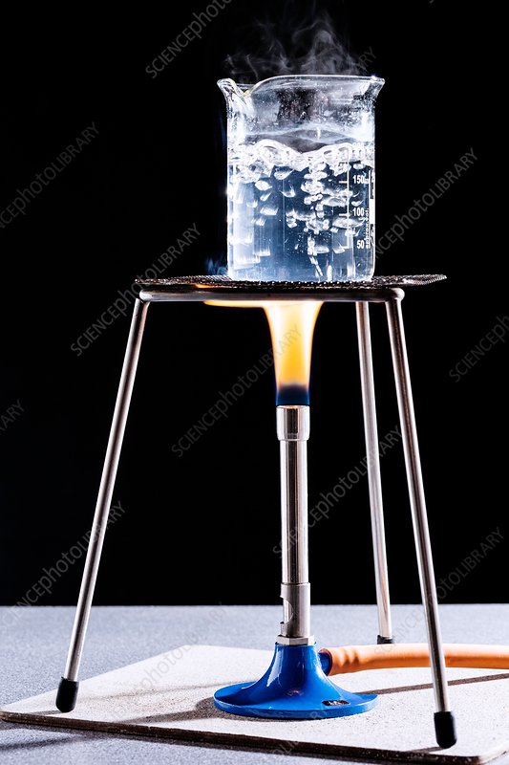
Application task – I do
In this experiment:
The observation is that water gets hot.
The hypothesis is that heat from the flame makes the water hot.
The prediction is the longer the water is heated, the hotter it gets.
The experiment changes the length of time the water is heated and measures the change in temperature.

Slide 9
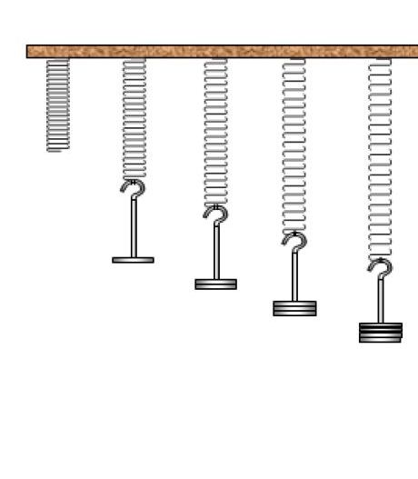
Application task – I do
In this experiment:
The observation is that springs stretch.
The hypothesis is that a force stretches a spring.
The prediction is the bigger the force, the longer the spring gets.
The experiment changes weight on the spring and measures the length of the spring.

Slide 10
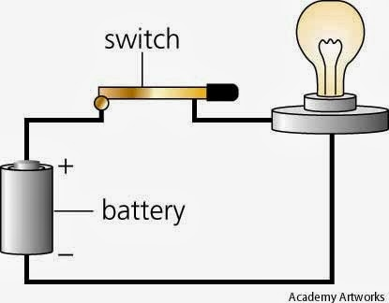
Application task – we do
In this experiment:
The observation is a _______ makes the _______ light up.
The hypothesis is that the _________ from the battery lights the bulb.
The prediction is the ________ the voltage, the ______ the bulb.
The experiment changes the _______________and measures the __________________.
Notes:
Battery, bulb, voltage, higher, brighter, number of batteries, brightness of the bulb.

Slide 11
Application task – we do
In this experiment:
The observation is a battery makes the bulb light up.
The hypothesis is that the voltage from the battery lights the bulb.
The prediction is the higher the voltage, the brighter the bulb.
The experiment changes the number of batteries and measures the brightness of the bulb.
Notes:
Battery, bulb, voltage, higher, brighter, number of batteries, brightness of the bulb.

Slide 12
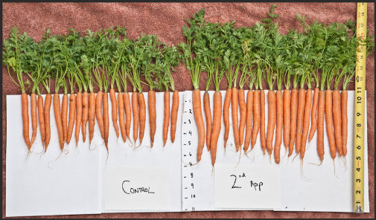
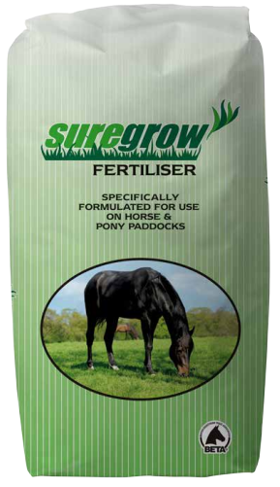
Application task
– you do
In this experiment:
The observation is….
The hypothesis is…
The prediction is…
The experiment changes… and measures…

Slide 13
Application task
– you do
In this experiment:
The observation is that carrots grow to different sizes.
The hypothesis is carrots need nutrients to grow.
The prediction is the greater the amount of nutrients, the bigger the carrots.
The experiment changes the amount of fertiliser the carrots get and measures the size of the carrots.

Slide 14
Plenary
What is a hypothesis?
What is an observation?
What is a prediction?

