Slide 1
Do now:
What do scientists do?
What makes a good scientist?
Why do scientists do experiment?

Slide 2
Do now:
What do scientists do? Find out things for themselves.
What makes a good scientist? They follow the scientific method
Why do scientists do experiments? To test their hypotheses.

Slide 3
I can name some famous female scientists
I can describe the achievements of famous female scientists
I can explain why female scientists are not mentioned in history as much as they should be
Notes:
Read to students

Slide 4
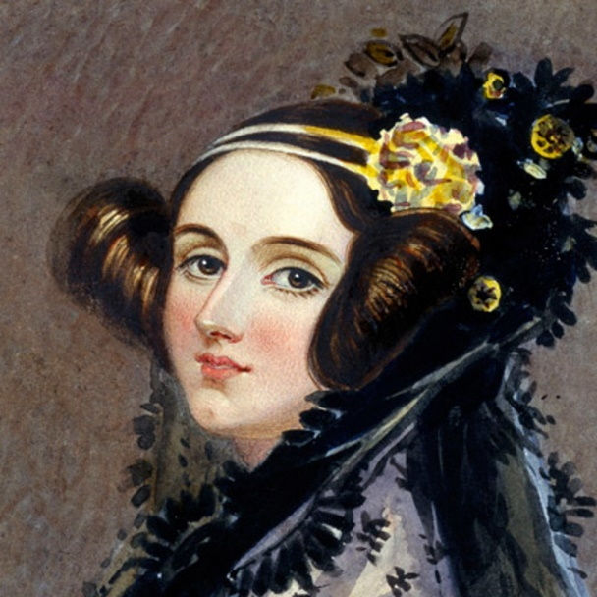
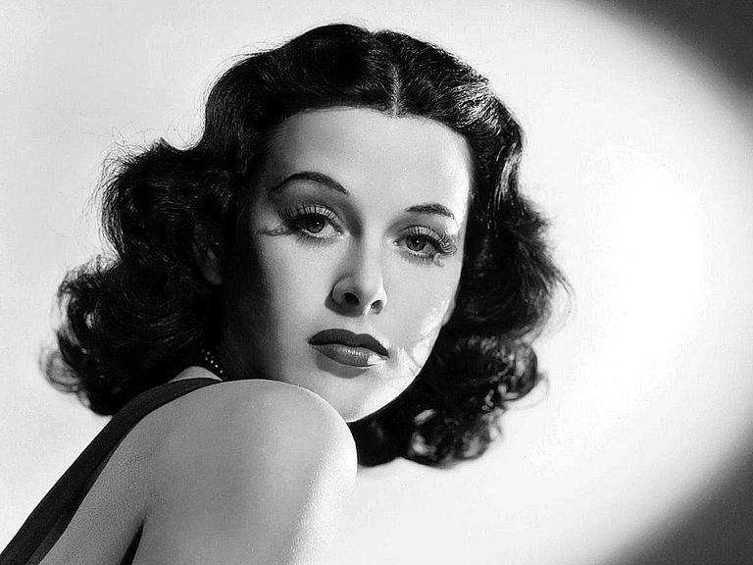
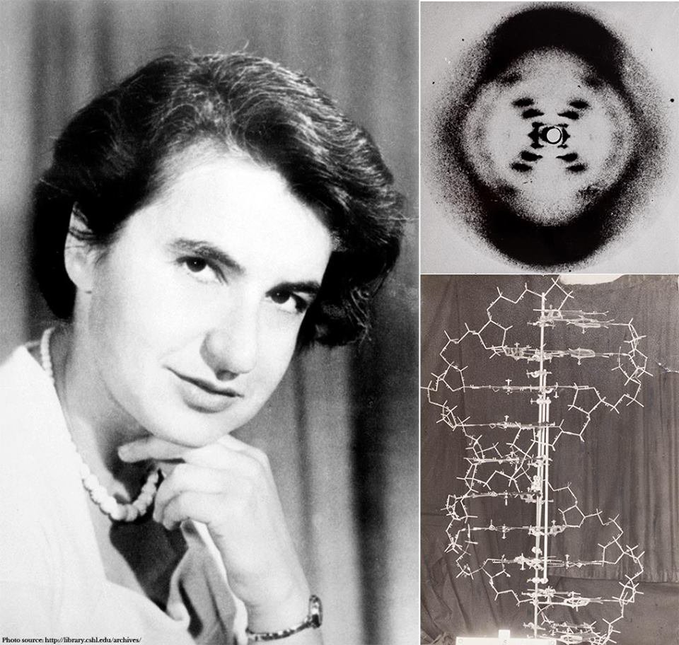
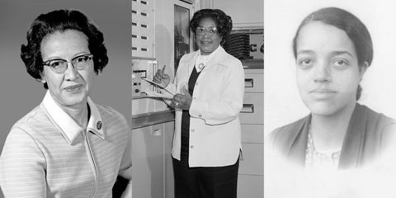
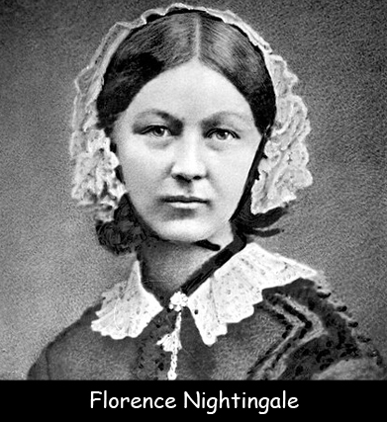
Notes:
Clockwise from top left. 1Ada Lovelace – mathematician and invented the concept of code/programming. Hedy Lamarr – designed radio frequency switching to control torpedoes in WW2. Now the same technology is called Bluetooth. Also a Hollywood star. 3. Rosalind Franklin – used X-ray crystallography to discover the structure of DNA. 4. Florence Nightingale – pioneered the use of hygiene in hospitals to avoid infection. 5. Katherine Johnson, Dorothy Vaughan and Mary Jackson. Mathematicians, prrogrammers and engineers who had key roles in first moon landing.

Slide 6
Pause point
What did Rosalind Franklin achieve?
She invented an injection
She took the first photographs of DNA molecules using X-rays
She invented DNA
She designed X-ray machines
Notes:
2

Slide 8
Pause point
What did the scientists in the film do?
Did the sums, computing and engineering to make sure the rocket didn’t miss the moon.
They were married to the astronauts
They were the astronauts.
Notes:
2

Slide 9
Key knowledge
Florence Nightingale | Pioneered the use of hygiene in hospitals
Rosalind Franklin | Developed the x-ray crystallography which allowed the discovery of the structure of DNA
Katherine Johnson, Dorothy Vaughan and Mary Jackson. | Mathematicians, computer programmers and engineers who did key jobs in making the NASA moon landings possible.
Ada Lovelace | A mathematician who developed the idea of computer code and software in the early 1800s!
Hedy Lamarr | Developed band switching of radio frequency during world war 2 to control torpedos but now we call this Bluetooth. Also a Hollywood star!
Notes:
Read through the slide with students then cover up the key knowledge.

Slide 10
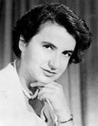
Application task – I do
Scientist's name: Rosalind Franklin
Scientist's achievement: She used X-ray crytallography to analyse the structure of a biologial moecule called DNA. This work would be crucial in understanding the shape of the molecule.
Adversity faced: Her work was shared without her position and this made two male scientists very famous. her work was likely undervalued because of sexism.

Slide 11
Application task – You do
Use the information sheets to analysie the work of more femal scientists. Use the same structure as we did in the 'I do'.
Scientists name:
Scientists achievement:
Adversity faced:

Slide 12
Plenary
What is a hypothesis?
What is an observation?
What is a prediction?

