Slide 1
Do now:
Where was zero incorporated into mathematical thinking?
Where was gunpowder invented?
Where was there pioneering work on chemistry, optics and mathematics (to name just a few) during medieval times?

Slide 2
Do now:
Where was zero incorporated into mathematical thinking? India
Where was gunpowder invented? China
Where was there pioneering work on chemistry, optics and mathematics (to name just a few) during medieval times? North Africa/the Middle East

Slide 3
I can name some famous BAME scientists
I can describe the achievements of famous BAME scientists
I can explain why BAME scientists are not mentioned in history as much as they should be
Notes:
Read to students

Slide 4
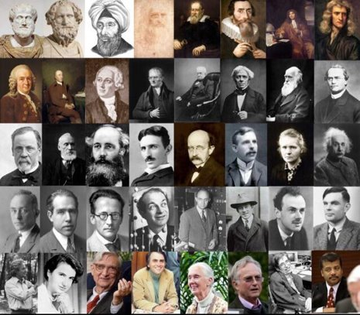
Notes:
We already discussed in last lesson how biases in society blocked access to universities. T

Slide 5
Notes:
This will have carried on much later than you realise. There ware barriers to BAME access to university even today. But now there is awareness and challenge.

Slide 6
Pause point
Which of these do you agree with?
BAME scientists have equal access to university as everyone else.
BAME scientists are under-represented at university.
BAME scientists are under-represented at university and there is a need for positive action.
Notes:
1

Slide 7
Notes:
There are organisations to champion BAME scientists.

Slide 8
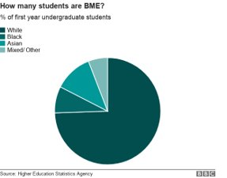
Notes:
It is working. BAME students are actually over represented now at univeristy but work is not yet complete – their representation, particularly of black students is lower at Russelll group univerisities.

Slide 9
Pause point
Is the bursary provided by Stormzy for black students to go to Cambridge right or wrong??
Right
Wrong
Don’t know
Notes:
1

Slide 10
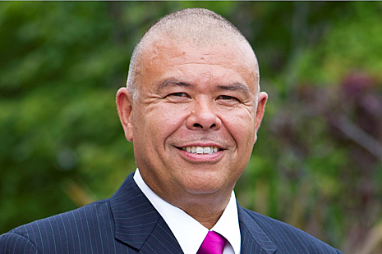
Jonathan Stafford Nguyen Van-Tam
Notes:
Jonathan Stafford Nguyen Van-Tam MBE (born 2 February 1964) is a British specialist in influenza, including its epidemiology, transmission, vaccinology, antiviral drugs and pandemic preparedness. On 2 October 2017 he took up the role of Deputy Chief Medical Officer for England.
Van-Tam attended Boston Grammar School in Boston, Lincolnshire where his father, Paul Nguyen Van-Tam, was a teacher of mathematics.[3] He graduated in Medicine from the University of Nottingham in 1987.[2]

Slide 11
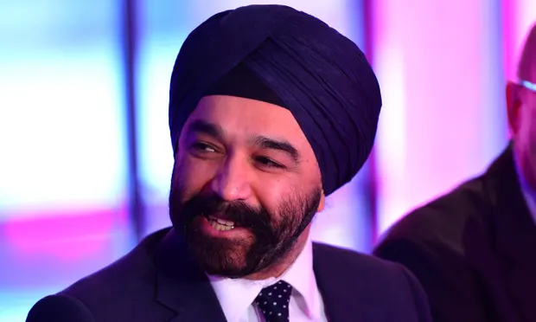
Sir Harpal Singh Kumar
Notes:
Sir Harpal Singh Kumar (born 1965) is a British medical researcher who was the chief executive officer of Cancer Research UK[1][2][3] until June 2018,[4] when he left the charity to become Head of Johnson & Johnson Innovation EMEA.[5]
Kumar's parents were refugees. As Sikhs, they chose to leave what was to become Pakistan and move to India, where they ended up in refugee camps. Later they moved to England, where his father was employed sweeping factory floors, before eventually starting his own grocery store.[6]
Kumar attended Latymer Upper School, Hammersmith, and St. John's College, Cambridge, where he gained a Master of Engineering degree and a Master of Arts degree and won the Mobil Prize, Metal Box Prize, and Hughes Prize. He subsequently gained a Master of Business Administration degree with High Distinction as a Baker Scholar at Harvard Business School where he won the Ford Prize and the Wolfe Prize.[7][8]

Slide 12
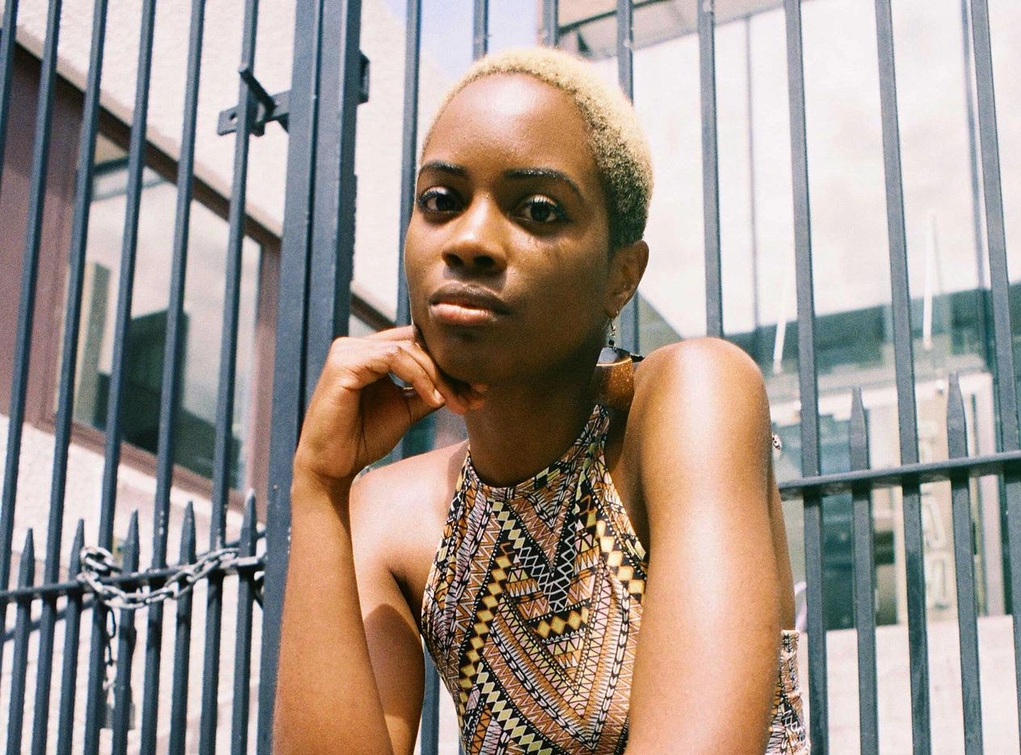
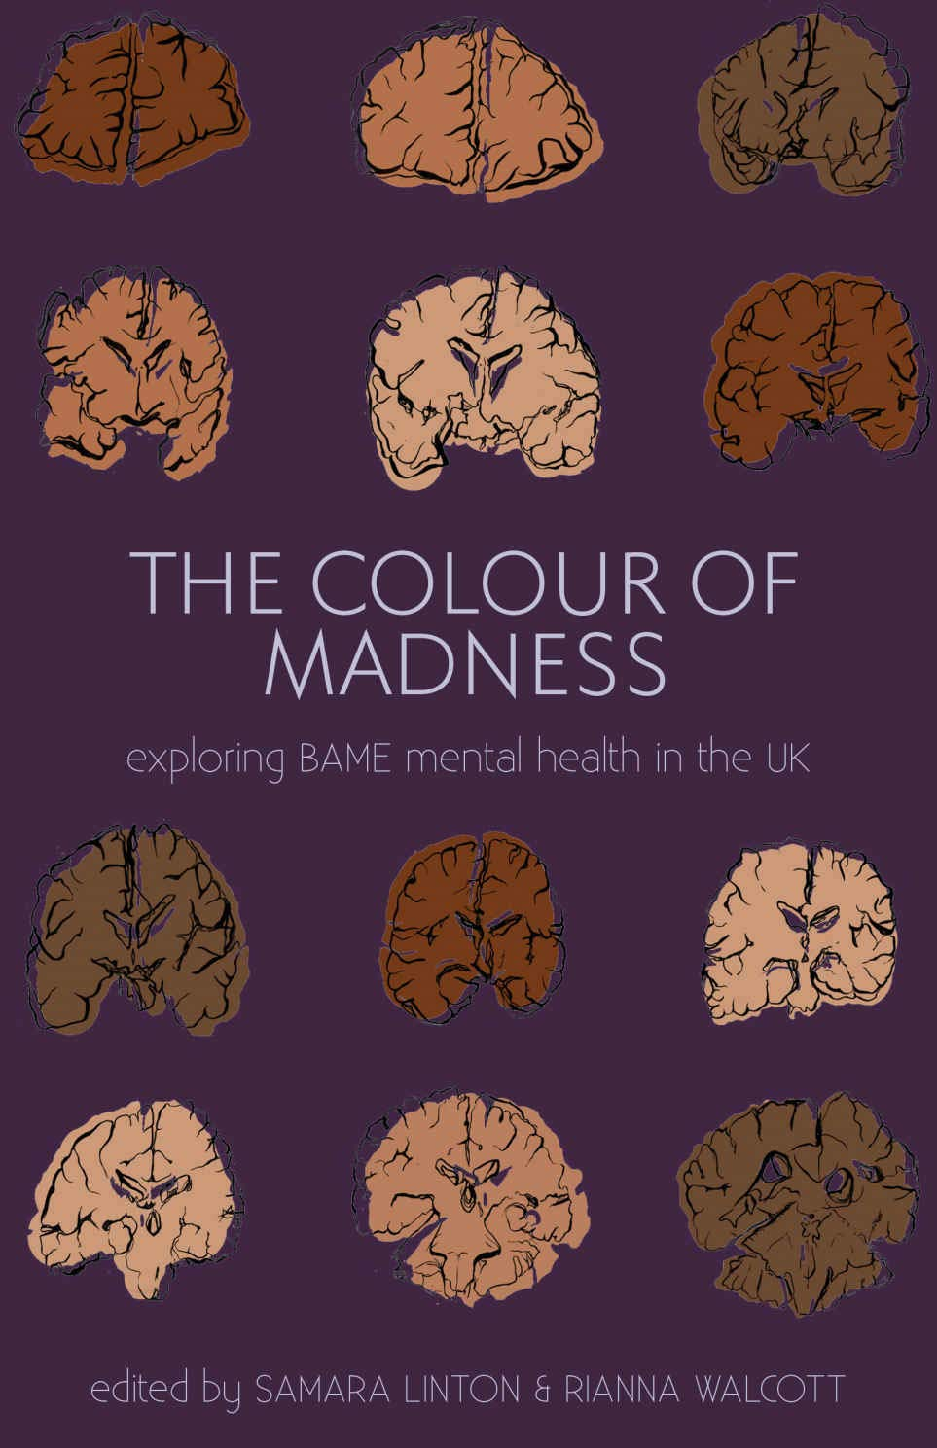
Samara Linton
Notes:
Samara Linton is a junior doctor, award-winning writer, and the editor of The Colour of Madness, an anthology exploring Black, Asian, and Minority Ethnic (BAME) mental health. She currently works at BBC Three as a production trainee.
Samara has written articles for the Royal College of Psychiatrists, the British Medical Journal, Black Ballad, Huffington Post UK, The Metro, and gal-dem. In 2016, she was awarded Best New Journalist at the Ending Violence Against Women Media Awards for her work on black women’s mental health and the detention of undocumented migrants in the UK. March 2016 saw the Parliamentary launch of Lessons from Ebola Affected Communities: being prepared for future health crises, a report she co-edited for the Africa All-Party Parliamentary Group. The report was described as “open and honest” by Lord Chidgey, and then DFID Minister, Nick Hurd, said the report was “extremely useful and well-written.”
Samara was also the president of the London branch of Polygeia, an organisation which empowers students to research and write policy on global health issues. Samara has also published and presented research on race and mental health and is a collaborator for the Cactus Foundation Global Mental Health Survey.

Slide 13
Key knowledge
BAME | Black, asian and minority ethnic.
Russell group | The 24 universities that are rated best, particularly as research establishments.
STEM | Science, technology, engineering and maths.
Positive action | Permitted action by an employer to assist protected groups which are disadvantaged or under-represented in a particular job.
Notes:
Read through the slide with students then cover up the key knowledge. It is called positive action as positve discrimination is illegal.

Slide 14
Application task – I do
Justify a case of positive action to increase representation of BAME in STEM. My example, the work of BBSTEM (Black British professionals in STEM)
I think that the work of BBSTEM is really important.
The reason why their work is importnan is they provide role models of BAME professionals working in STEM that people at school and college might not otherwise learn about.
The positive outcome of this is that more BAME students will be inspired to choose science at college and university to lead to equal representation in the sector.

Slide 15
Application task – you do
Justify a case of positive action to increase representation of BAME in STEM. Your example, the bursary created by Stormzy to finance black university applicants to study at Cambridge.
I think that the work of Stormzy is...
The reason why his bursary is important is...
The positive outcome of his bursary will be...

Slide 16
Plenary
What does BAME stand for?
What does STEM stand for?

Slide 17
Plenary
What does BAME stand for? Black, asian and minority ethnic
What does STEM stand for? Science, technology, engineering and maths

