Slide 1
Do now:
What does BAME stand for?
What does STEM stand for?
What is positive action?

Slide 2
Do now:
What does BAME stand for? Black, Asian and minority ethnic
What does STEM stand for? Science, technology, engineering and maths
What is positive action? Working to support a group that is under-represented

Slide 3
I can name some Salfordian and Mancunian scientists
I can timeline developments in STEM in the local area
I can recognise Salford and Manchester as one of the world's most innovative places.
Notes:
Read to students

Slide 4
List the science and engineering you hear mentioned.
Notes:
Dr Patricia Lewis (1957-)
Arms expert Dr Patricia Lewis, a dual national of Britain and Ireland, holds a BSc in physics from the University of Manchester.
Now a nuclear physicist, Dr Lewis served as Director of the United Nations Institute for Disarmament Research (UNIDIR) in Geneva from 1997-2008.
She is now research director for international security at Chatham House and received the American Physical Society’s 2009 Joseph A. Burton Forum award for her work on physics and society.
Dr Aravind Vijayaraghavan is an expert in the field of nanotechnology with further broad ranging expertise in most aspects of materials science and engineering, general physical sciences, biomedical sciences and physical chemistry.

Slide 5
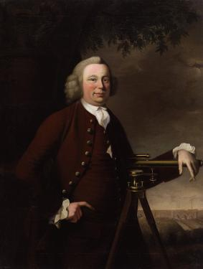
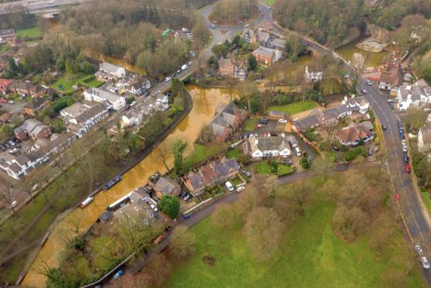
Notes:
Mid 1700s. James Brindley, engineer built drainage systems for the Wet Earth colliery at Clifton and the Bridgewater canal which drained the coal mines at Worsley Delph. There are 47 miles of underground canals to service the mine and his engineering works were so successful that the price of coal in Manchester halved.

Slide 6
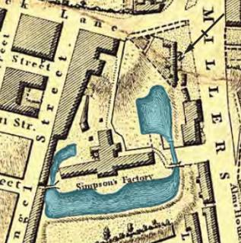
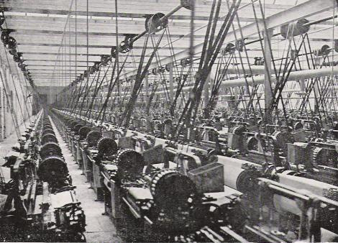
Notes:
Arkwrights mill, Shudehill. 1796. A very early steam powered cotton mill.

Slide 7
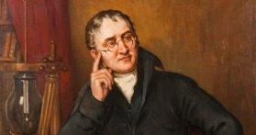
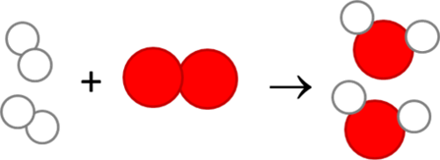
Notes:
John Dalton - 6 September 1766 – 27 July 1844. Proposed model for the atom.

Slide 8
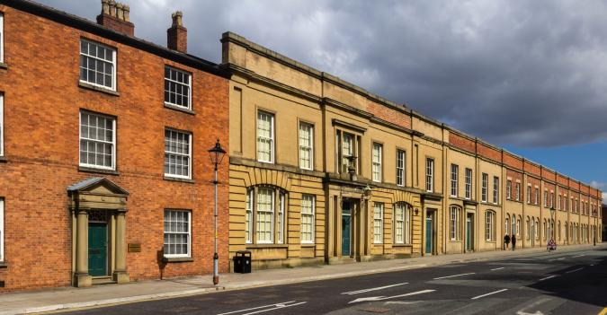
Notes:
1830 – the worlds oldest surviving passenger railway station. Around a mile from the Academy.

Slide 9
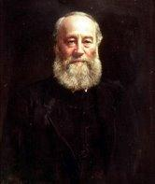
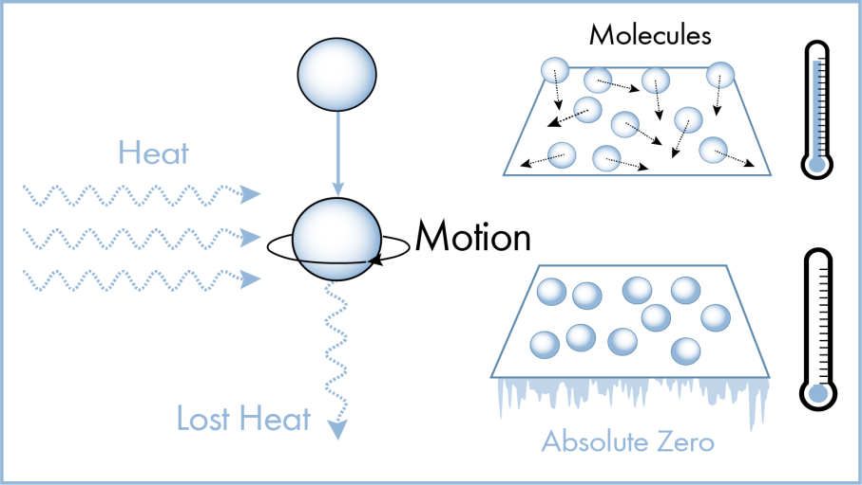
Notes:
24 December 1818 – 11 October 1889. Work on the energy of heat and the birth of the science of thermodynamics. The unit for energy is named after him. Salford born and bred.

Slide 10
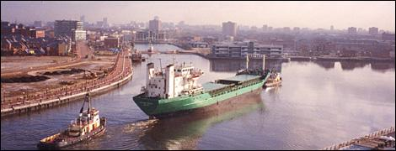
Notes:
1894 – The Manchester ship canal opens. At it opening, it was the largest river navigation canal in the world capable of carrying ships up to 200m long. By the 1950s, 18.5 million tonnes of goods came up the canal into Salford Docks, then called Port Manchester. Kellogg's is where it is because grain from the US prairies came across the great Lakes, down the Hudson, through New York, across the Atlantic and up the ship canal to Trafford park.

Slide 11
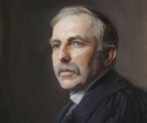
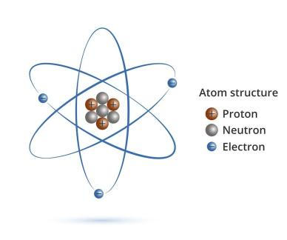
Notes:
Ernest Lord Rutherford. 30 August 1871 – 19 October 1937. Discovery of the nucleus of the atom as a small, positive and heavy part of the atom. Work done at the University of Manchester. A major step forwards in physics and chemistry.

Slide 12
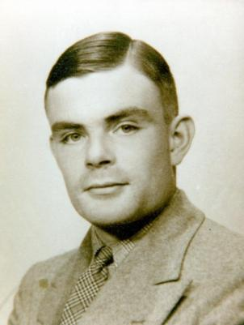
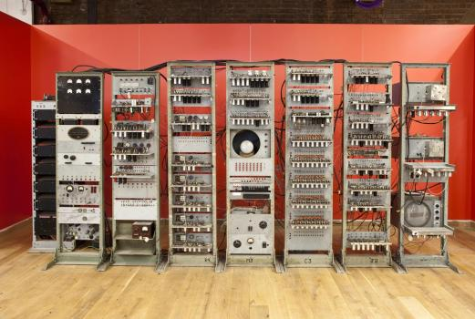
Notes:
Alan Turing 23 June 1912 – 7 June 1954. In 1948, Turing was appointed reader in the Mathematics Department at the Victoria University of Manchester. A year later, he became Deputy Director of the Computing Machine Laboratory, where he worked on software for one of the earliest stored-program computers—the Manchester Mark 1.

Slide 13
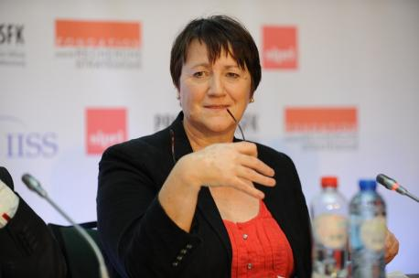
Notes:
Dr Patricia Lewis (1957-)
Arms expert Dr Patricia Lewis, a dual national of Britain and Ireland, holds a BSc in physics from the University of Manchester.
Now a nuclear physicist, Dr Lewis served as Director of the United Nations Institute for Disarmament Research (UNIDIR) in Geneva from 1997-2008.
She is now research director for international security at Chatham House and received the American Physical Society’s 2009 Joseph A. Burton Forum award for her work on physics and society.
Dr Aravind Vijayaraghavan is an expert in the field of nanotechnology with further broad ranging expertise in most aspects of materials science and engineering, general physical sciences, biomedical sciences and physical chemistry.

Slide 14
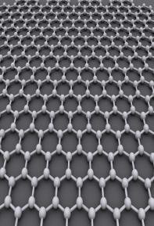
Notes:
Discovery of graphene - 2004

Slide 15
Key knowledge
Graphene | A modern scientific discovery. A nanomaterial made from a single sheet of carbon with lots of future uses.
Ernest Rutherford | A scientist who discovered the structure of the atom while working at the University of Manchester.
James Joule | A Salford scientists who has the unit for energy named after him and developed the field of thermodynamics.
James Brindley | An expert in engineering, particularly drainage and canals.
Alan Turing | Developed the software for the Manchester mark 1 computer.
Patricia Lewis | A Manchester graduate who works for the UN security council and is an expert is nuclear disarmament.
Liverpool street station | The oldest passenger station in the world (which is still standing)
John Dalton | Proposed that each element had its own type of atom
Arkwright's mill | A very early steam powered mill
Manchester ship canal | At the time of building the largest canal in the world.

Slide 16
Application task – Timeline I do/you do
Place the facts and dates ona timeline which shows the proud STEM history of Manchester and Salford
Late 1990's onwards
Mid 1700s
Early 1800s
Mid 1800s
Early 1900s
1794
1830
1894
1950s
2004
Alan Turing developed the software for the Manchester Mark 1 computer
James Brindley's engineering
Arkwrights mill
John Dalton propses idea of the atom
Liverpool street station built
Manchester ship canal opens
Rutherford discovers structure of the atom
Graphene discovered
James Joules work on thermodynamics
Dr Patricia Lewis works for UN security council

Slide 17
Plenary
List 3 important discoveries that were made in Manchester and Salford.

